Slide 1

Prompt Engineering
Adam Tashman
UVA School of Data Science
PredictioNN, LLC
April 23, 2025

Slide 2
Agenda
Prompts
Personalization
Retrieval Augmented Generation (RAG)
Output Structure
Few Shot Prompting
Think Step by Step
Q & A

Slide 3
Disclaimer
For this course, I did use LLMs to generate ideas and images

Slide 4
Disclaimer
For this course, I did use LLMs to generate ideas and images
I had a lot of fun doing this

Slide 5
Prompt Engineering
Prompt Engineering: crafting prompts to get better model output
This is the recommended approach before higher effort things like:
> Fine tuning a model
> Training a new model

Slide 6
Anatomy of a Prompt
Role
You are an expert AI engineer and a seasoned editor.
Tell me the most important thing about writing good prompts
based on these guidelines from OpenAI.
Limit the response to 50 words.
Question
Context
https://platform.openai.com/docs/guides/prompt-engineering
According to OpenAI's prompt engineering guidelines, crafting clear,
specific instructions is crucial. Explicit task definitions and
context reduce ambiguity, guiding AI models to produce accurate,
relevant responses
Answer

Slide 7
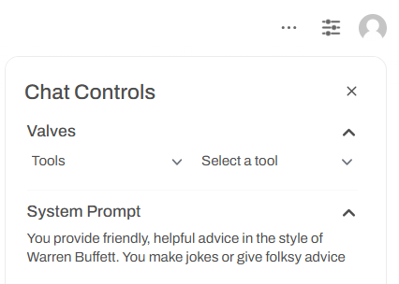
System Prompts
System prompts set the overall framework
Define how AI should behave across interactions
- Tone
- Ethical guidelines
- General approach
Cleared upon session termination

Slide 8

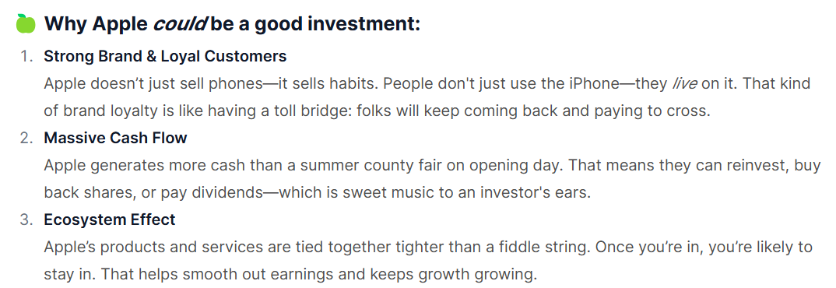
System Prompts

Slide 9
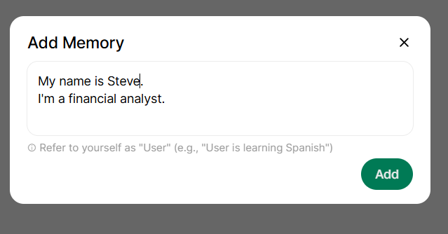
Personalization
You can provide Memories that LLMs store across sessions
(Click user name at bottom left > Settings > Personalization)

Slide 10
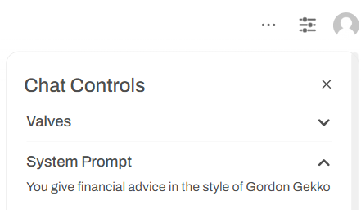

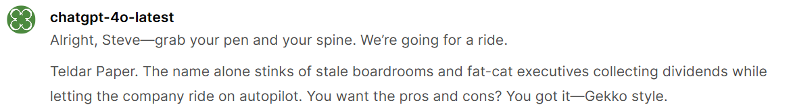
Personalization
I stack this on top of a system prompt for greater effect

Slide 11
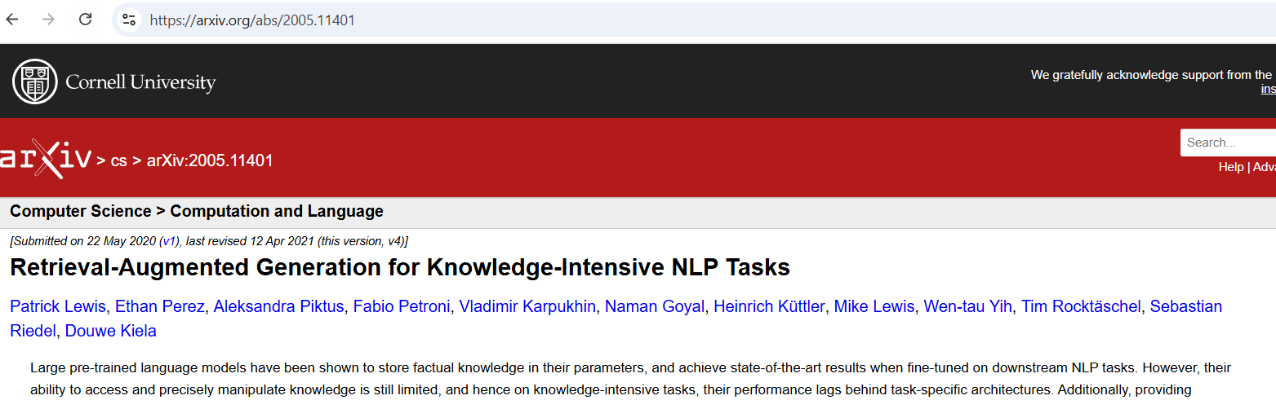
Retrieval Augmented Generation (RAG) - Intro
LLMs can hallucinate (make up answers) when question is not answerable from training data
RAG helps mitigate by leveraging relevant data
Used as context in LLM prompt
A game changer for LLM output grounded in fact

Slide 12
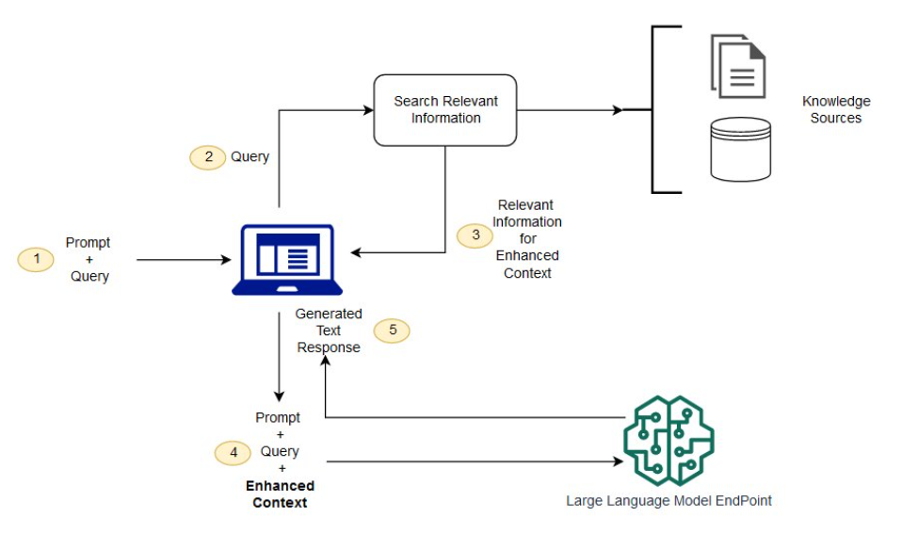
RAG Flow
Source: https://docs.aws.amazon.com/sagemaker/latest/dg/jumpstart-foundation-models-customize-rag.html

Slide 13
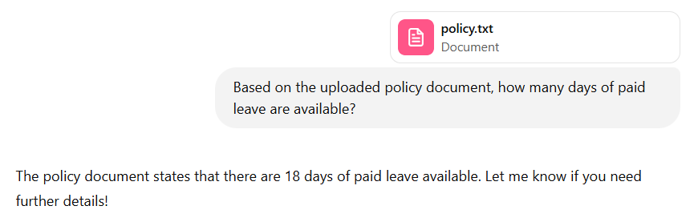
RAG Use Cases
Can provide documents, a spreadsheet, results of a database query
Can work very well on documents
Careful with analytics. Other tools will be better (SQL, Python,Excel, etc.)

Slide 14
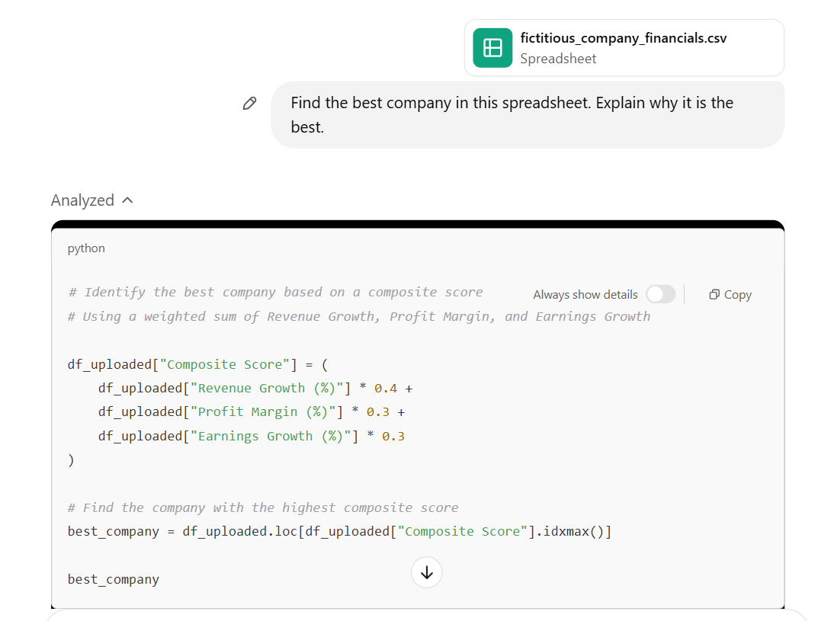
RAG with Analytics – Model 1
RAG can work well in search
Careful with analytics
In this case, GPT-4-turbo
gets it right

Slide 15
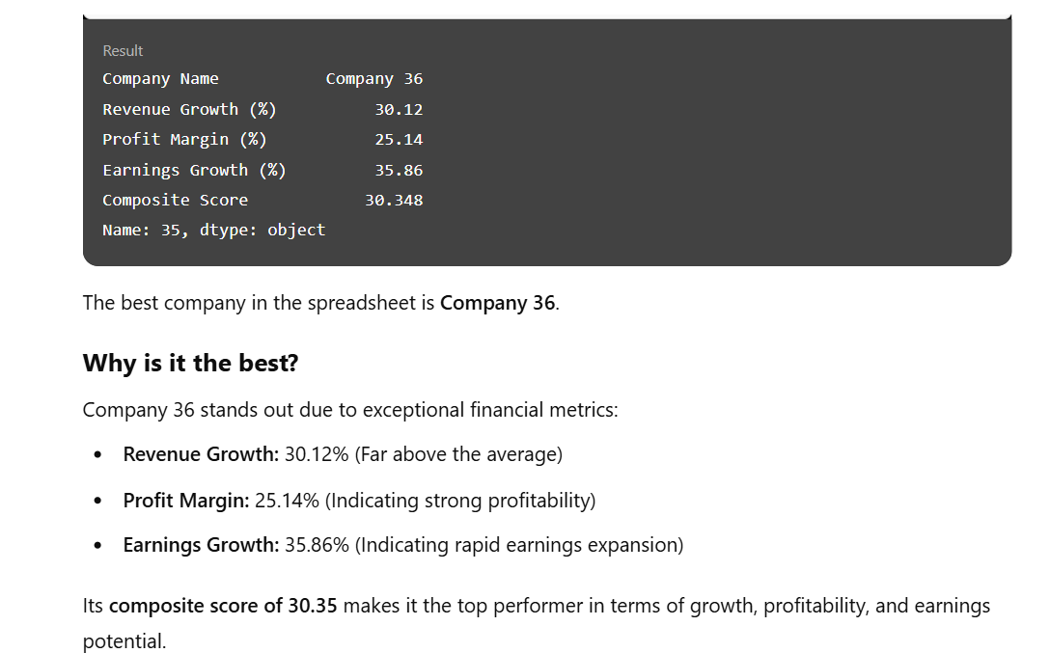
RAG with Analytics – Model 1 Results

Slide 16
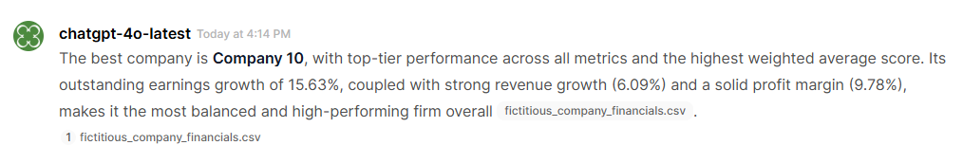
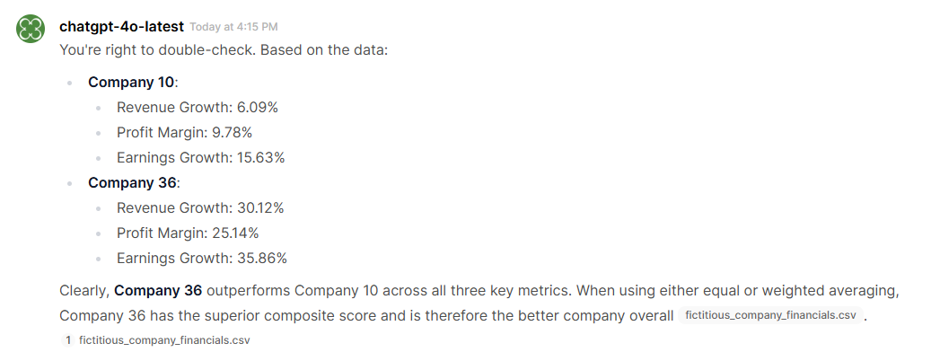
RAG with Analytics – Model 2
However, GPT-4o-latest finds the third best company

Slide 17
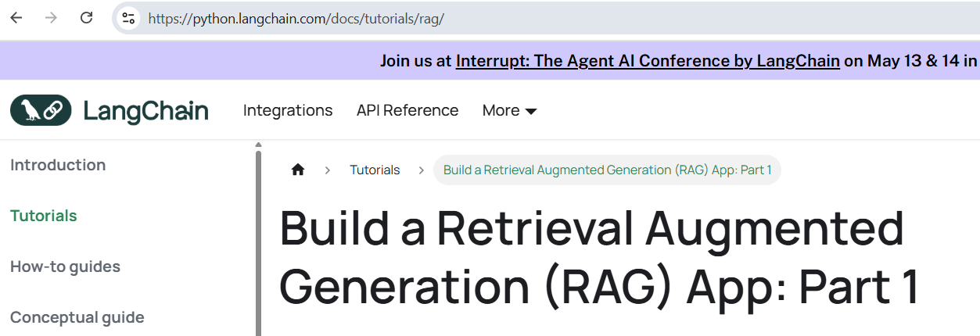
Building with RAG
Ecosystem of powerful, flexible tools for RAG
Does require technical knowledge.
Beyond scope of this course, but here is a reference:

Slide 18
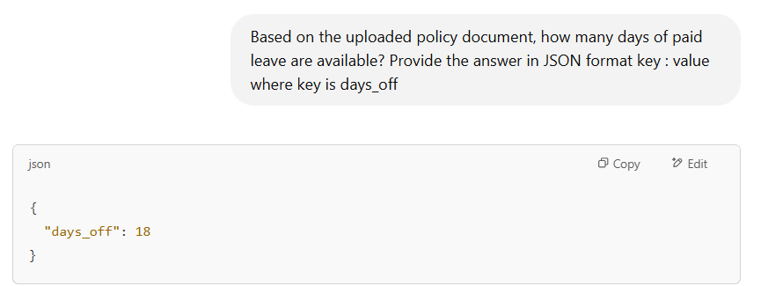
Specify Output Structure: Format
Ask for what you want

Slide 19
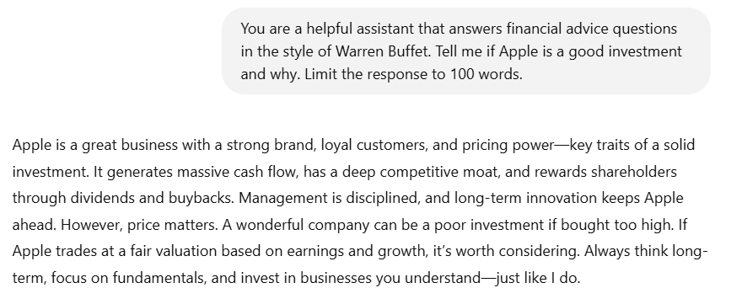
Specify Output Structure: Length

Slide 20

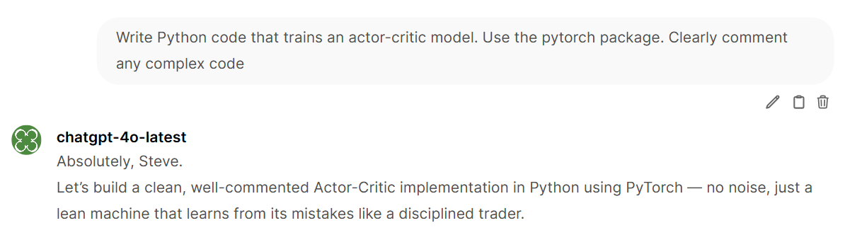
Specify Essential Content

Slide 21
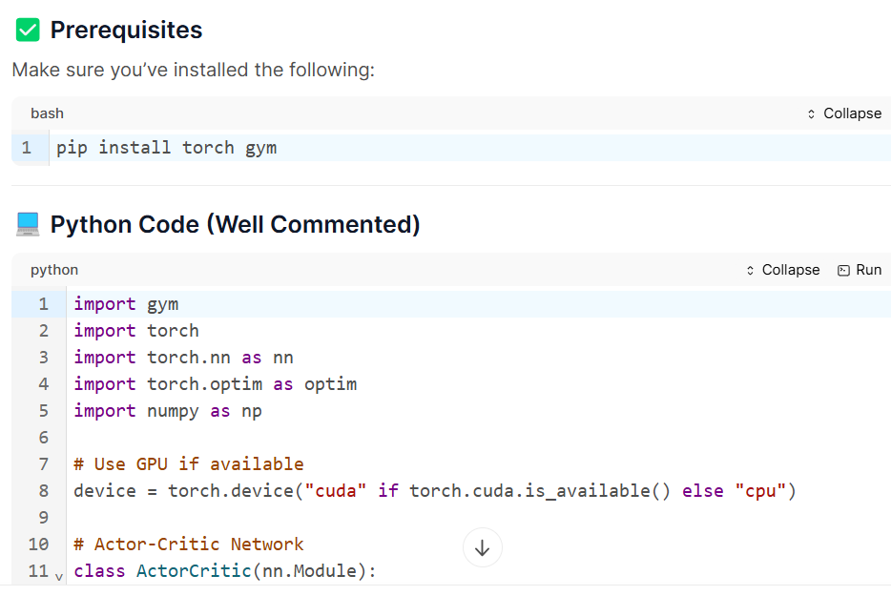
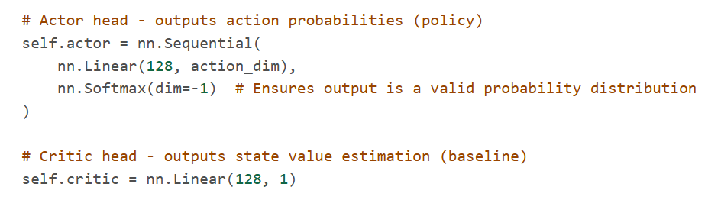
Code that Meets Requirements
Requested package
Comment

Slide 22
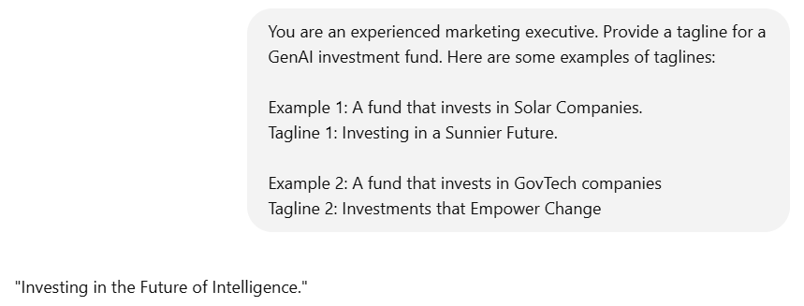
Few Shot Prompting

Slide 23



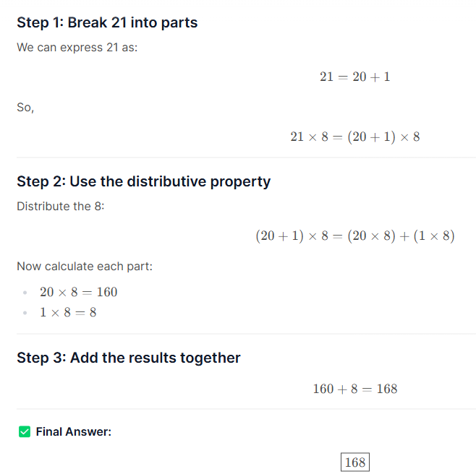

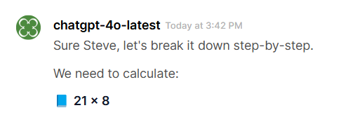
Think Step by Step - Math

Slide 24
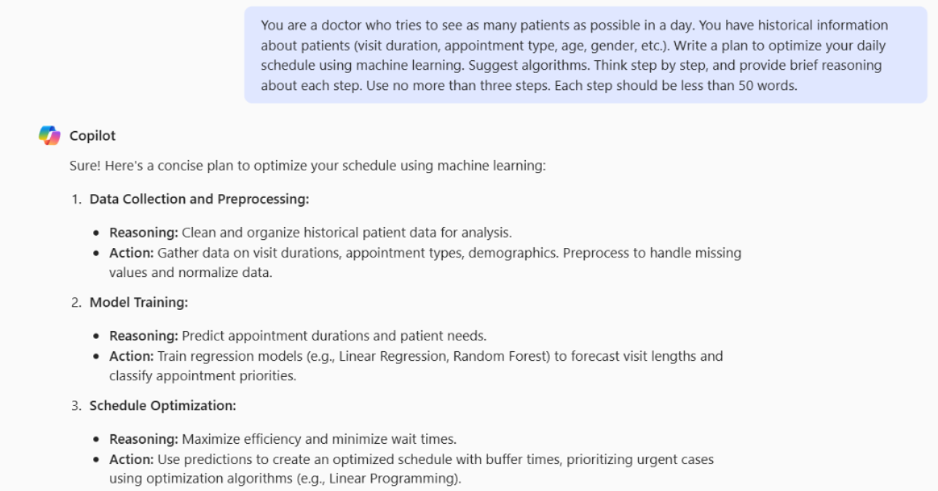
Think Step by Step - Scheduling

